Slide 1


4. Final Testing and
Reporting

Slide 2
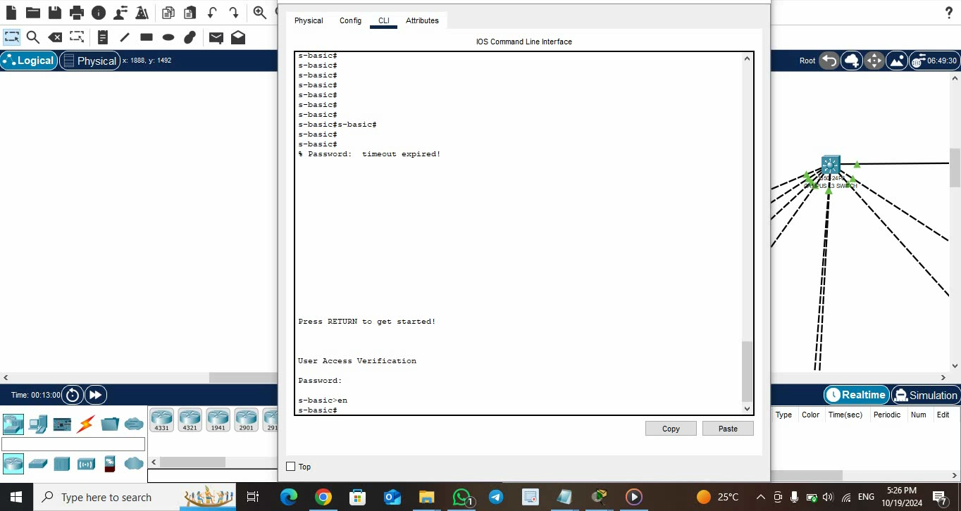
VLANS Configuration & Connectivity between VLANs

